Slide 1
Chapter TWO
Application, Session and Presentation Layers

Slide 2
Application Layer Introduction
It is the topmost layer that has an interaction with the user.
The application layer is responsible for providing services to the user.
The application layer enables the user, whether human or software, to access the network.
It provides user interfaces and support for services such as electronic mail, remote file access and transfer, shared database management, and other types of distributed information services.

Slide 3
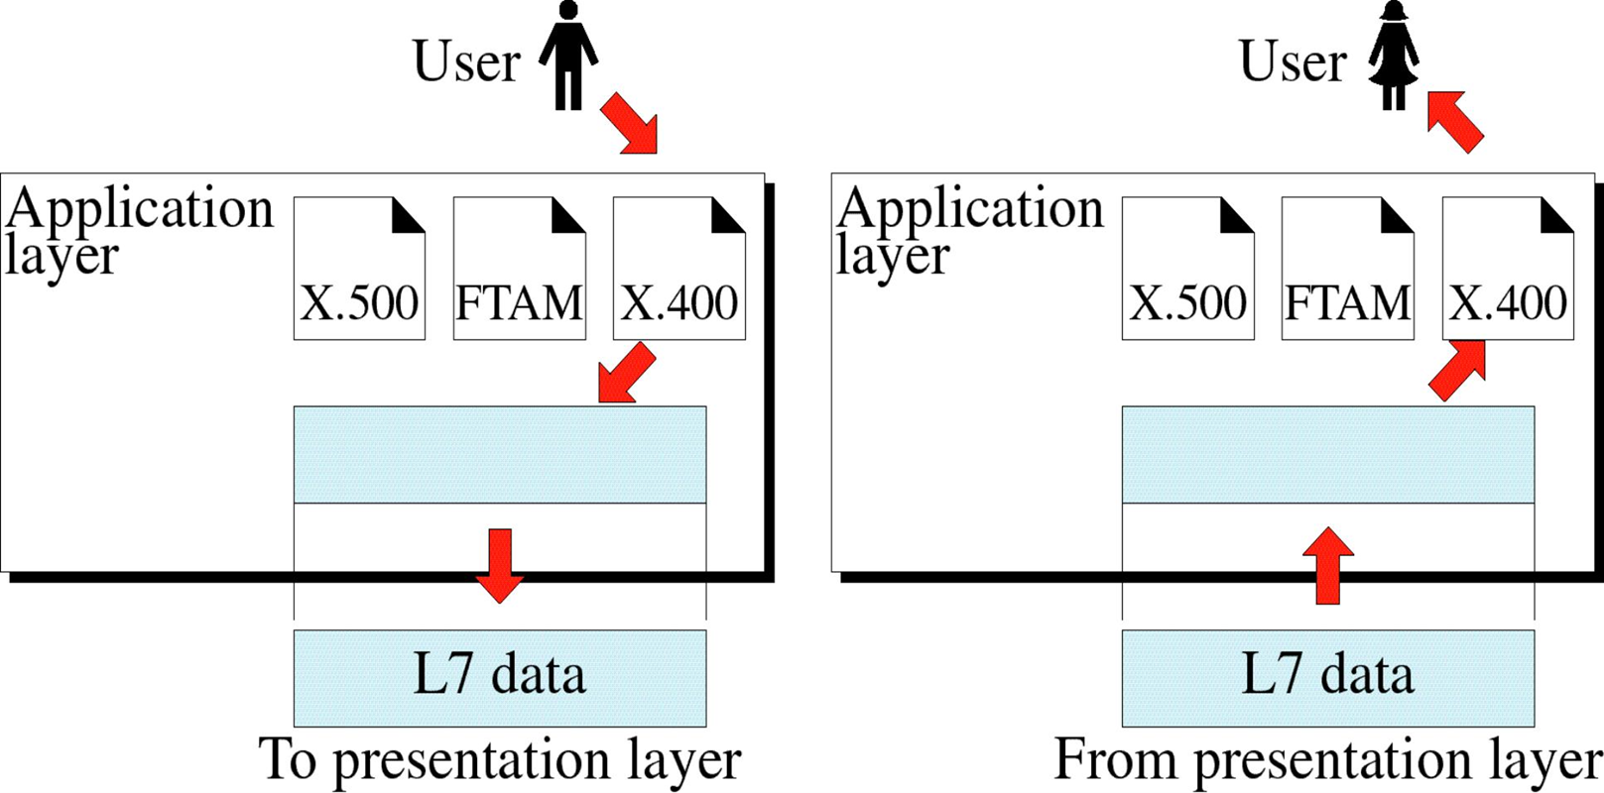
Cont..

Slide 4
Functions of Application Layer
Mail Services: This application provides various e- mail services.
File transfer & Access: It allows users to access files in a remote host, to retrieve files from remote computer for use etc.
Remote log-in: A user can log into a remote computer and access the resources of that computer.
Accessing the World Wide Web: Most common application today is the access of the World Wide Web.

Slide 5
Client-Server Model
Client server model serve as the foundation for application layer programs.
An application program running on the local machine sends a request to another application program is known as client and a program that reply for a request is known as a server.
For example when a web server receives a request from the client host, it responds to the request to the client host.
A server is a fixed machine that has a well known address known as IP address .
It is always on, while the clients can always contact the server.

Slide 6
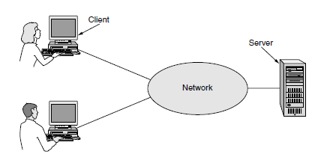
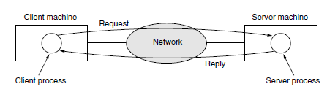

Slide 7
Cont..
For example when a browser wants to access a Web page, it sends the name of the page it wants to the server hosting the page using HTTP.
The server then sends the page back.
Other application protocols are used for file transfer, electronic mail, and so on.

Slide 8
Application Layer Protocols
Application layer protocols are commands for specific applications.
Protocols are fundamental aspects of digital communication.
For example, a web browser uses HTTP to access webpages from a web server.
And an email client uses SMTP to send electronic mails through a mail server.
Some of these protocols are:
HTTP – Hypertext Transfer Protocol
Allows transmitting all hypermedia documents.
Telnet
Allows communication to remote device or system.

Slide 9
Cont..
FTP – File Transfer Protocol.
It’s a protocol that is responsible for transferring files from one location to the other.
TFTP – Trivial File Transfer Protocol
Used to send a file from the server to the client.
SMTP - Simple Mail Transfer Protocol
Used to transfer electronic mail from one user to the other.
DNS - Domain Name System
a decentralized system for translating the domain name of devices to numerical IP address.
DHCP – Dynamic Host Configuration Protocol
To assign IP address to any device on a network dynamically so that they can communicate using this IP address.

Slide 10
Presentation Layer
Unlike the lower layers, which are mostly concerned with moving bits around, the presentation layer is concerned with the syntax and semantics of the information transmitted.
In order to make it possible for computers with different internal data representations to communicate, the data structures to be exchanged can be defined in an abstract way.
The presentation layer manages these abstract data structures and allows higher-level data structures (e.g., banking records) to be defined and exchanged.
It was designed for data encryption, decryption and compression.

Slide 11
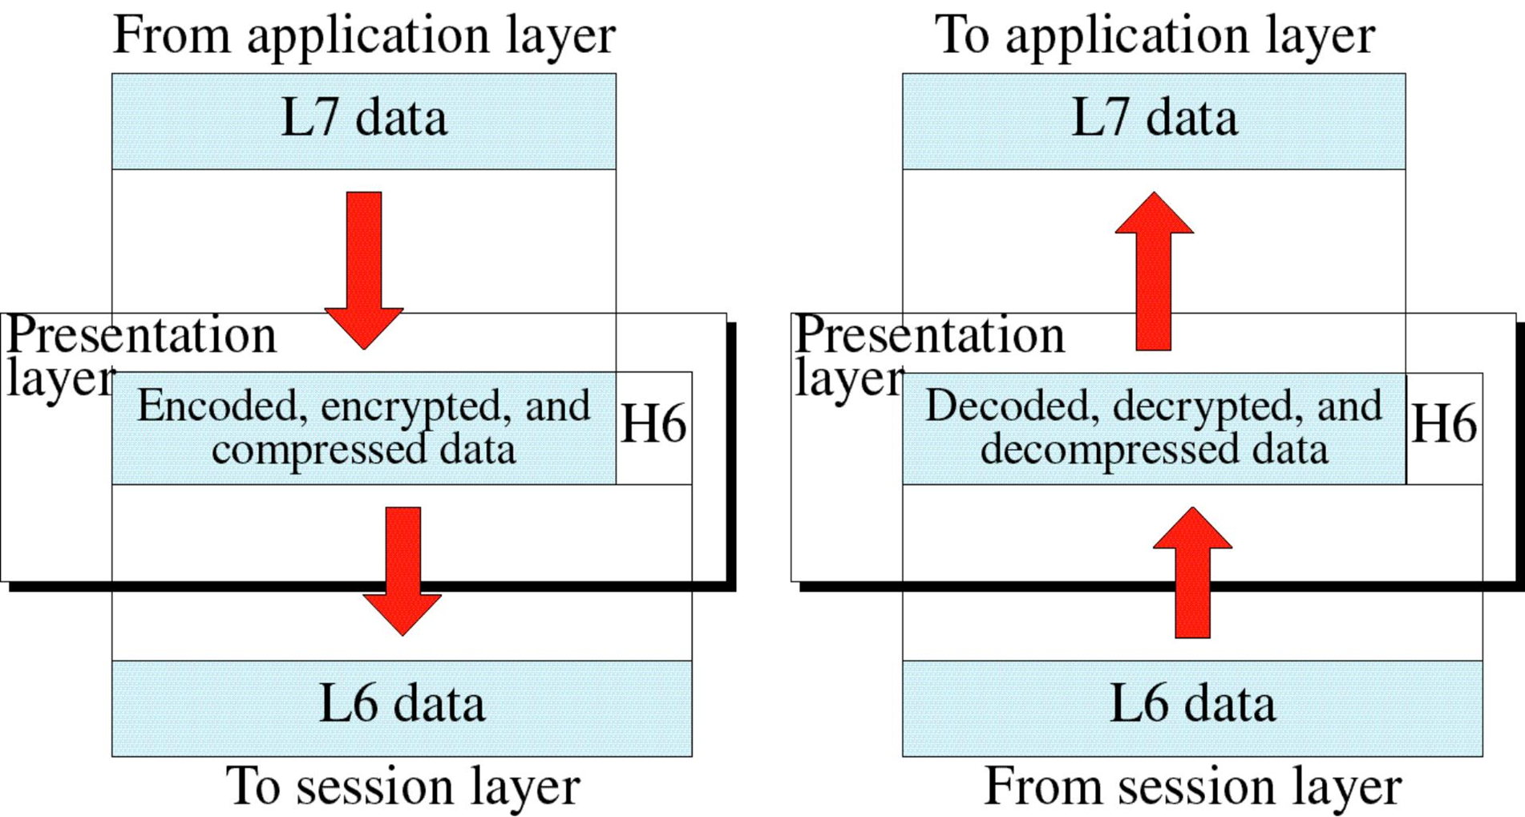
Cont..

Slide 12
Functions of Presentation Layer
Data Presentation or Translation:
The processes (running programs) in two systems are usually exchanging information in the form of character strings, numbers, and so on.
Because different computers use different encoding systems data representation or translation is needed.

Slide 13
Cont..
It ensures that the data being sent is in the format that the recipient can process.
The presentation layer at the sender changes the information from its sender-dependent format into a common format.
The presentation layer at the receiving machine changes the common format into its receiver-dependent format.

Slide 14
Cont..
Data Encryption:
To carry sensitive information, a system must be able to ensure privacy.
Encryption means that the sender transforms the original information to another form that is completely different from the original message and sends this message over the network.
Decryption reverses the above process (encryption) to transform the message back to its original form.

Slide 15
Cont..
Presentation layer provides this facility by hiding the information from everyone except the person who originally sent the information & the intended recipient.
When encrypted data arrives at destination, Presentation layer decrypts the message.
Thus, only the sender and receiver can properly encode and decode data so it returns to a readable format.

Slide 16
Cont..
Data Compression:
Presentation layer shrinks large amount of data into smaller pieces i.e. it reduces the size of data.
Data compression reduces the number of bits contained in the information.
Data compression becomes particularly important in the transmission of multimedia such as text, audio, and video.

Slide 17
Session Layer
Session layer has the responsibility of beginning, maintaining and ending the communication between two devices, called session.
Sessions includes various services or processes, including dialog control (keeping track of whose turn it is to transmit), token management (preventing two parties from attempting the same critical operation simultaneously), and synchronization (check pointing long transmissions to allow them to pick up from where they left off in the event of a crash and subsequent recovery).
The Session Layer allows users on different machines to establish active communication or sessions between them.

Slide 18
Cont..
Session layer also provides an orderly communication between devices by regulating the flow of data.
It is where a place authentication and authorization takes place.

Slide 19
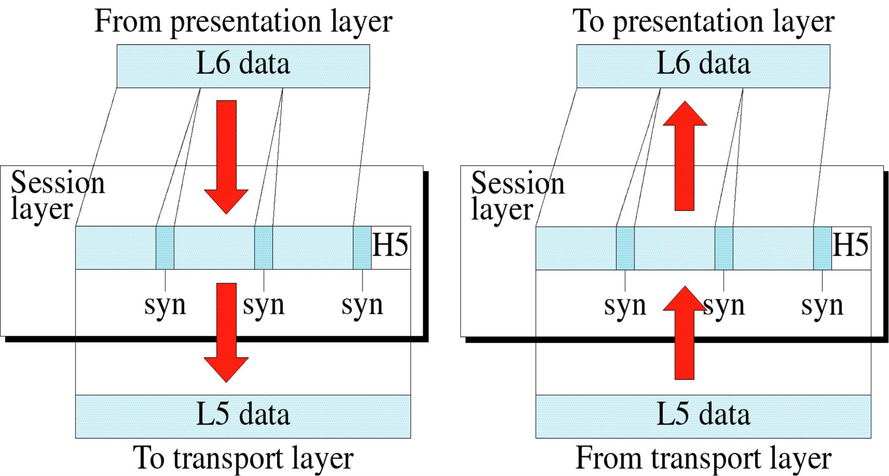
Cont..

Slide 20
Functions of Session Layer
Establishing, Maintaining and ending a session:
The sending device first contact with the receiving device, it sends syn (synchronization) packet to establish a connection and determines the order in which information will be sent.
Receiver sends ack (acknowledgement).
So the session can be set and the message prepared in presentation layer transmits to the receiver before the session ends.

Slide 21
End of the second chapter!

